Slide 1
Bank Marketing Logistics Regression Model

Slide 2
Overview
Find the best strategies to improve for the next marketing campaign. How can the financial institution have a greater effectiveness for future marketing campaigns? In order to answer this, we have to analyze the last marketing campaign the bank performed and identify the patterns that will help us find conclusions in order to develop future strategies.
Business Goal
To explain how machine Learning can help in a bank marketing campaign. The goal of our classifier is to predict using the logistic regression algorithm if a client may subscribe to a fixed term deposit. Often, more than one contact to the same client was required, in order to access if the product would be "Yes" or "No" subscribed.

Slide 3
Steps for Logistic Regression
Reading the Data
EDA on the read Data
Inferences from EDA of categorical and numerical variables
Data Preparation
Splitting the data into test and train datasets
Logistic Regression, Predictions & Evaluations

Slide 4
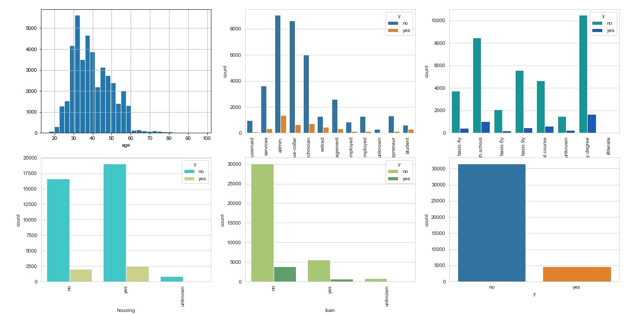
Inferences from EDA of categorical and numerical variables:

Slide 5
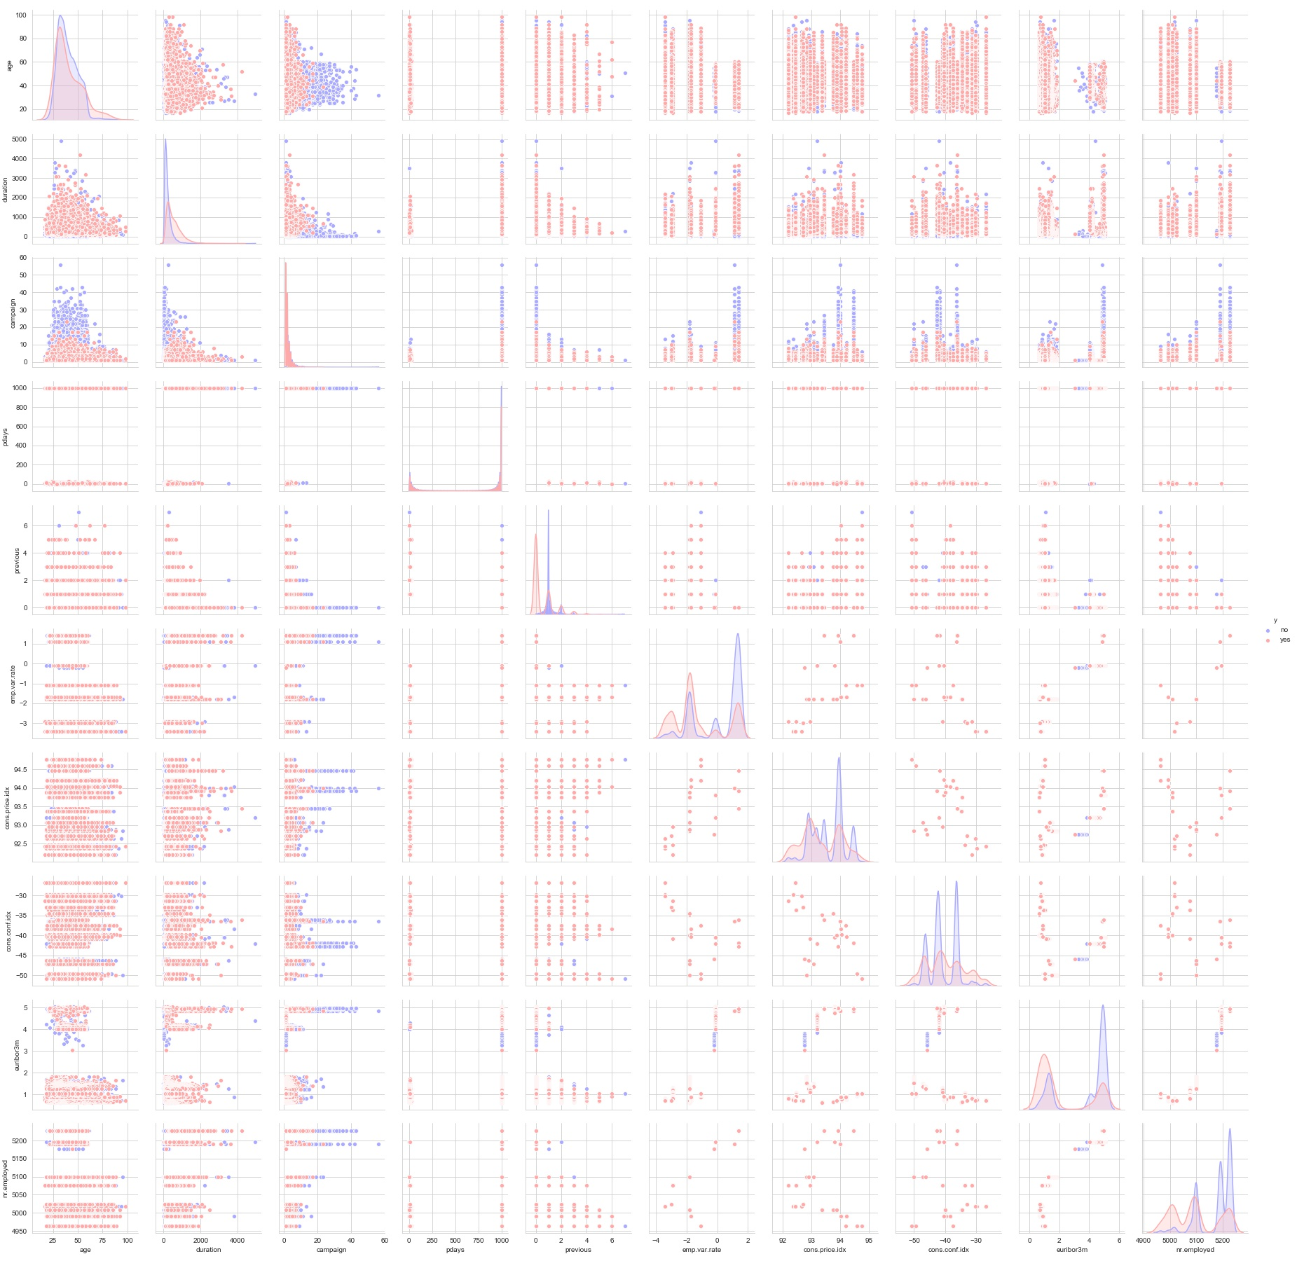
Cont.

Slide 6
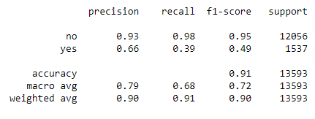
Predictions & Evaluation Results
Interpretation:
We arrived at a very decent model for the the demand for shared bikes with the significant variables
We can see that temperature variable is having the highest coefficient 0.4914, which means if the temperature increases by one unit the number of bike rentals increases by 0.4914 units.
Similarly, we can see coefficients of other variables in the equation for best fitted line.
We also see there are some variables with negative coefficients, A negative coefficient suggests that as the independent variable increases, the dependent variable tends to decrease. We have spring, mist cloudy , light snow variables with negative coefficient. The coefficient value signifies how much the mean of the dependent variable changes given a one-unit shift in the independent variable while holding other variables in the model constant.

